Slide 1

E-Commerce Retail Insights
By:- Vishal Chavanke

Slide 2
About me:-
Name:- Vishal Khanderao Chavanke.
Education:- B.sc Computer Science.
Linkedin:- www.linkedin.com/in/vishal-chavanke-b96839268
Github:- https://github.com/vishal0425

Slide 3

About E-Commerce Target Retailer:
Target is an e-commerce retailer
An e-commerce retailer is a business that sells products or services through a online storefront—like a website or mobile app—instead of a physical store.
Key Features of an E-Commerce Retailer
Online Storefront: Customers browse, select, and purchase items digitally.
Digital Transactions: Payments are made via credit cards, wallets, UPI, or other online methods.
Logistics & Delivery: Products are shipped directly to customers, often with tracking and estimated delivery dates.
Customer Data: Retailers collect data on purchases, preferences, and feedback to improve service and marketing.
Examples: Amazon, Flipkart, Myntra, and Target.

Slide 4
Why This Project?
Retail and e-commerce businesses store operational data (orders, customers, payments, products) in relational databases.
The Target dataset contains thousands of customers, orders, and reviews, making it ideal for analysis.
SQL is optimized for querying, filtering, and aggregating large datasets quickly.
With SQL joins, aggregations, and window functions, we can directly answer key business questions:
Like:
Which products generate the highest revenue?
What percentage of orders are delayed?
Who are the top-performing sellers?

Slide 5
Problem Statement:-
Target generates huge amount of data from customers, orders, products, payments, and reviews. But raw data has no value, Without Analysis
The Real challenge is to extract meaningful insights from the data.
Insights should help to:
Improve customer satisfaction
Optimize delivery performance
Track sales and revenue trends
Support better decision-making
Project Objectives:-
Understand customer behavior and retention.
Measure delivery performance (including delays).
Identify top-selling products and categories.
Evaluate payment trends and revenue contribution.
Finally Provide insights that can target improve sales & operations.

Slide 6
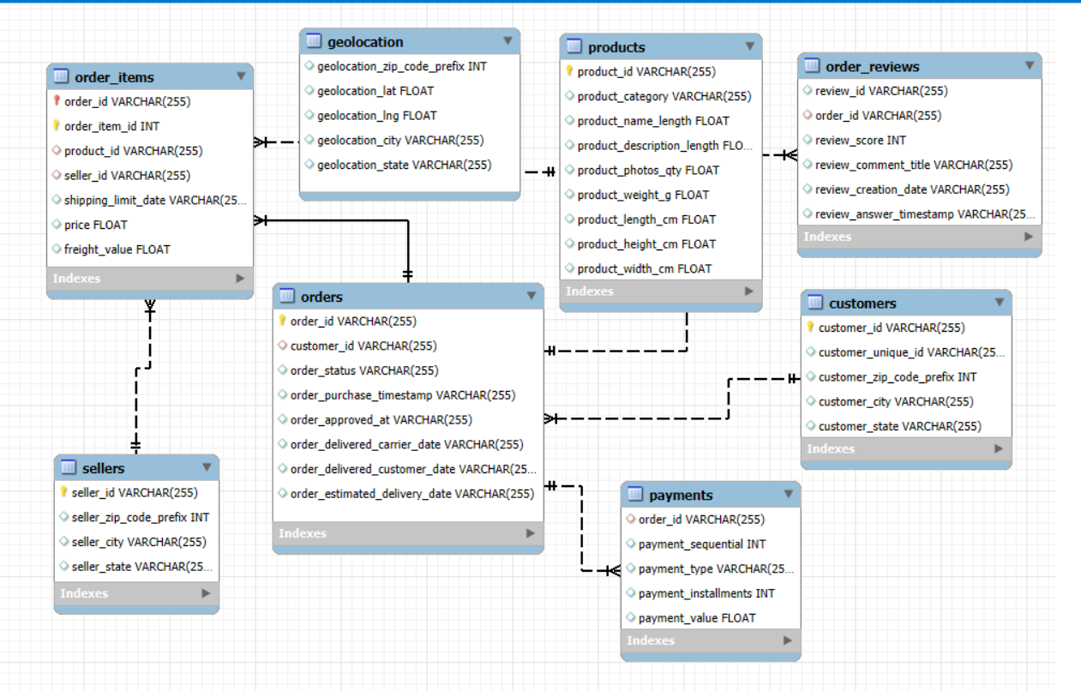
ER:- Entity-Relationship Diagram.

Slide 7
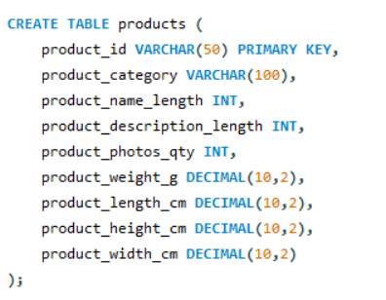
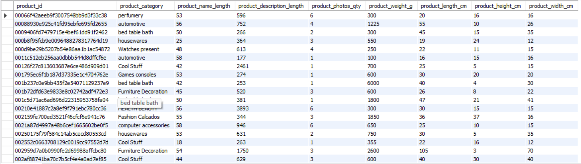
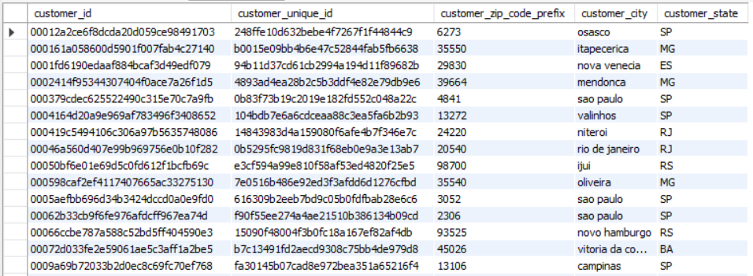
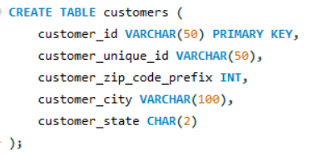
Table Creation Queries:-
Products:-
Customers

Slide 8
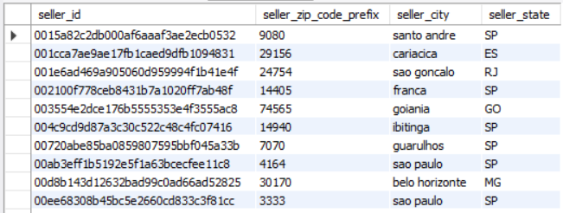
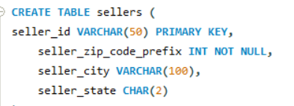
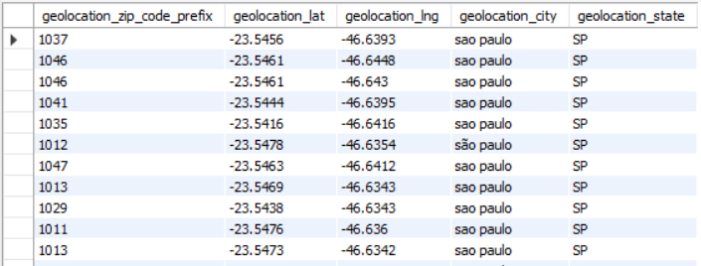
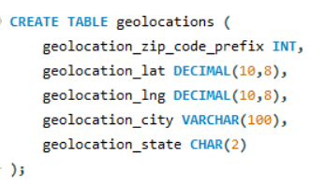
Seller Table:-
Geolocations:-

Slide 9
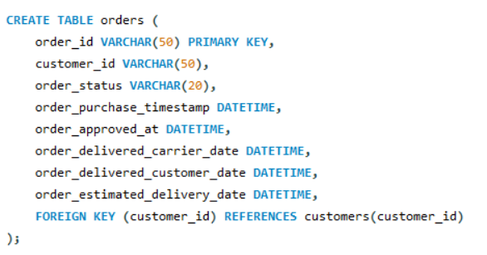
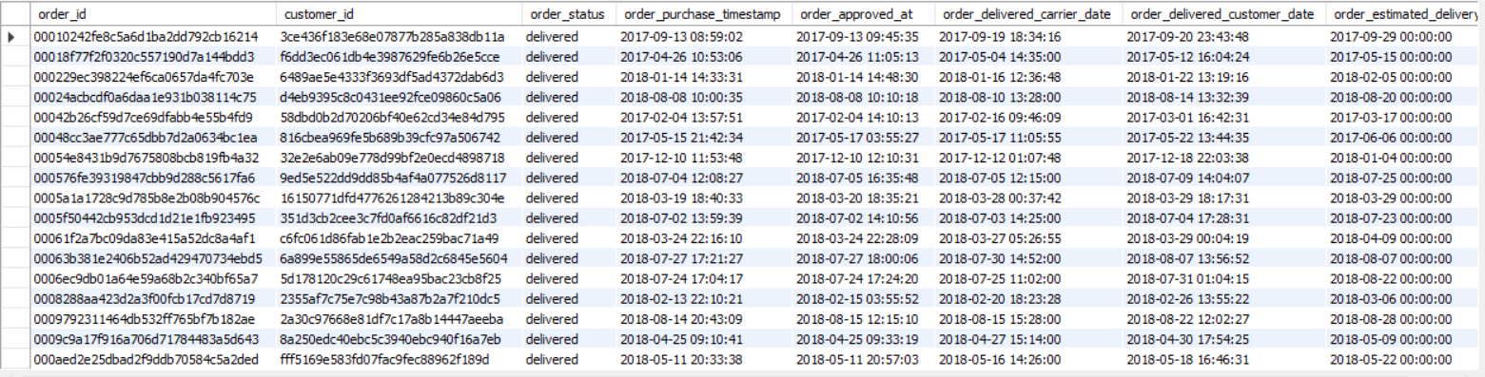
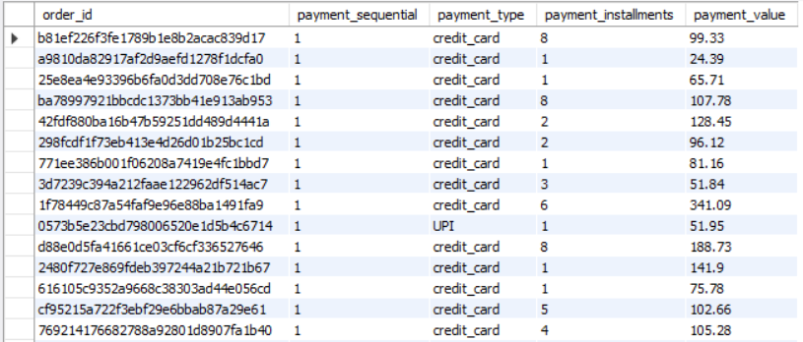
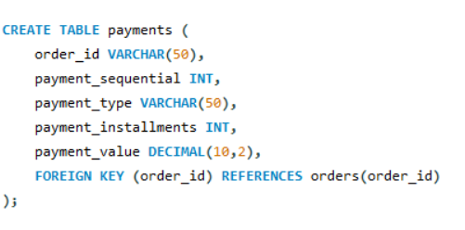
Orders:-
Payments:-

Slide 10
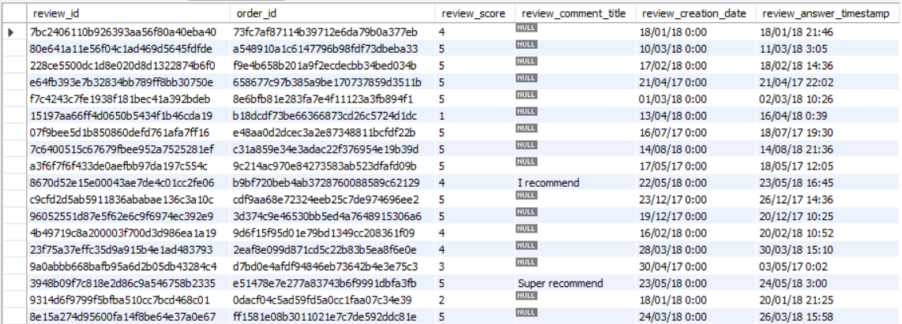
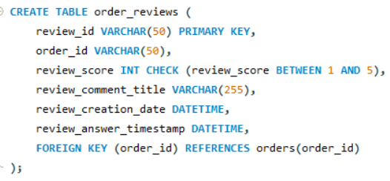
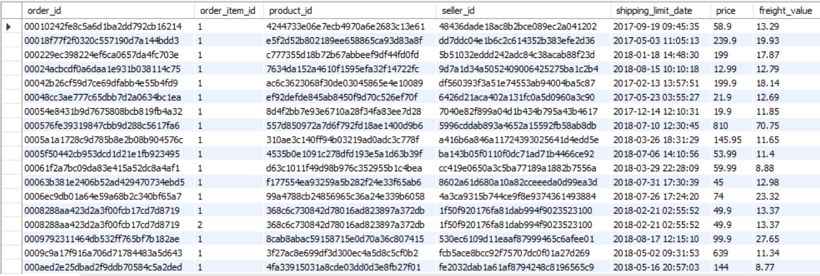
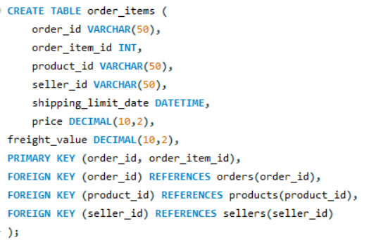
Order_reviews:-
Order_items:-

Slide 11
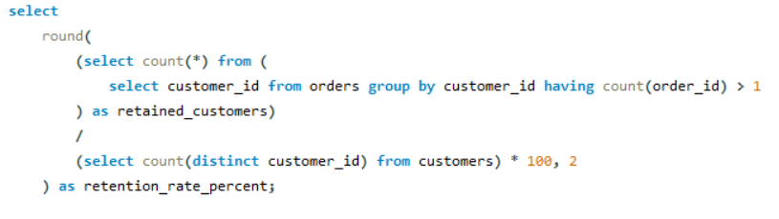
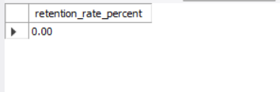
Key Business Questions & Insights
Customer Analysis
1) Customer retention rate (customers who placed more than 1 order)
Observation:
0.00% retention rate
The dataset shows no repeat customers
all customers purchased only once.
This indicates very poor retention and highlights the need for strategies to improve customer loyalty.

Slide 12
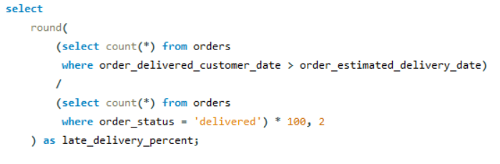
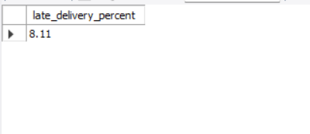
Order & Delivery Analysis
2). Percentage of Orders Delivered Late vs. Estimated Date.
Observation:
Only 8.11% of orders were delivered late. This shows that delivery performance is generally strong,
but there's still room to improve for faster service

Slide 13
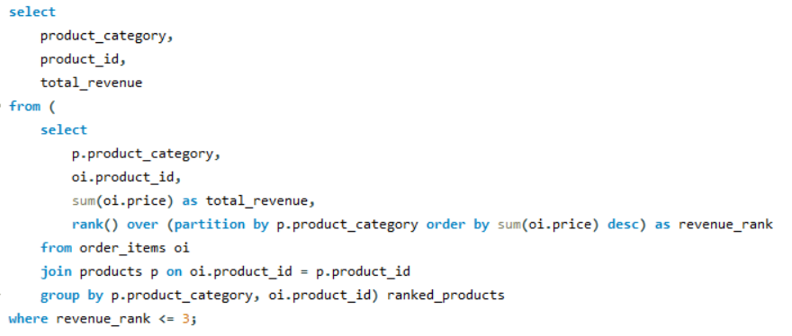
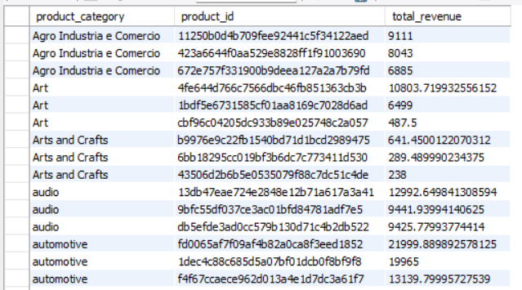
3). Top 3 Products by Revenue in Each Category
Product & Category Analysis
Observation:
Automotive products lead with over $21,999 Dollars in total revenue.
This category shows strong demand and high-value purchases.
Audio and Art categories generating $12,992 & $10,000 respectively.
These both segments reflect consistent interest in lifestyle and creative goods.

Slide 14
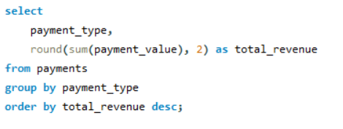
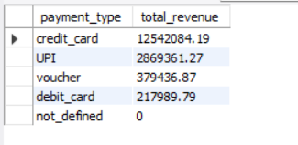
Payment & Revenue Analysis
4). Calculate revenue by payment type.
Observation:
Credit cards generated $1.25 crore Dollar in revenue
highest revenue.
This shows customer trust in credit card payments
UPI contributed $28.69 lakh, and vouchers and debit cards have smaller revenue

Slide 15
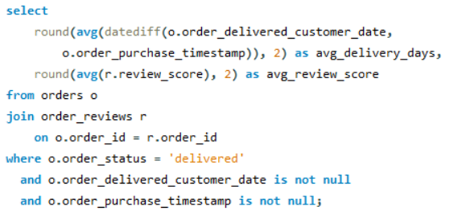
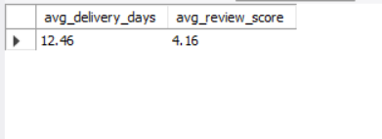
5). Correlation Between Delivery Time and Review Score
Review Analysis
Observation:
Average delivery time is 12.46 days, and the average review score is 4.16.
This suggests that customers are generally satisfied even with moderate delivery times.
Review scores remain high despite longer delivery durations.
It indicates that product quality and service may matter more than speed for customer satisfaction.

Slide 16
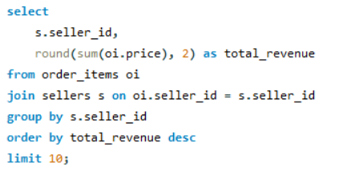
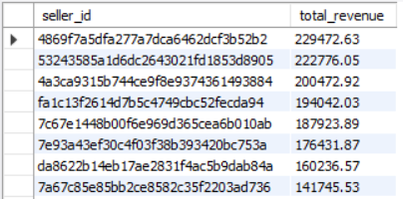
6) sellers with the highest total sales revenue..
Seller & Location Analysis
Observation:
Top seller generated $2.29 lakh Dollars in total revenue.
This highlights strong individual performance and potential for seller-level optimization.
Revenue of top 10 sellers ranges from $1.41 lakh Dollars to $2.29 lakh Dollars

Slide 17
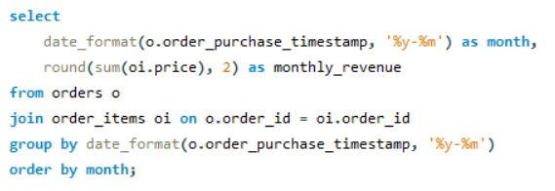
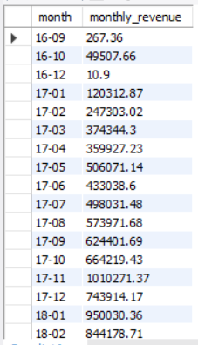
7) Monthly revenue growth.
Advanced Analytics
Observation:
Monthly revenue increased from $267 in Sep 2016 to $9.5 lakh by Jan 2018.
This shows strong business momentum and growing customer demand.
Revenue growth was consistent across months. It reflects successful scaling of operations and effective sales strategy.

Slide 18
Key Insights
Customer Analysis
Retention = 0% → all customers purchased only once → need loyalty strategies.
Order & Delivery
Only 8.11% late orders → strong logistics.
Avg. delivery = 12.46 days, but reviews still high (4.16) → quality > speed.
Product & Revenue
Automotive leads with $61.9K+ revenue → strong demand.
Audio ($27.9K) & Art ($11.7K) show steady lifestyle demand.
Credit cards dominate with $1.25 Cr revenue → high customer trust.
Seller Performance
Top seller = $2.29L, top 8 sellers between $1.41L–$2.29L → competitive.
Business Growth
Revenue grew from $267 (Sep 2016) → $9.5L (Jan 2018) → consistent scaling.

Slide 19
Conclusion
SQL analysis provided key business insights from Target’s e-commerce data.
Customer retention = 0% → all customers purchased only once.
Delivery performance strong → only 8.11% of orders arrived late.
Average delivery = 12.46 days, but customers still gave high reviews (avg. 4.16).
Credit cards dominate payments, generating ₹1.25 crore revenue.
Automotive category leads revenue, followed by Audio and Art.
Top sellers earned $1.41–2.29 lakh, showing competitive performance.
Revenue grew from $267 (2016) to $9.5 lakh (2018) → steady business growth.

Slide 20
Challenges Faced During the Project
Choosing the project → Initially difficult to decide, but finalized on Target retail dataset.
Understanding the domain → Had no prior knowledge about Target, researched to gain clarity.
Handling raw data → Dataset was very large, faced errors while importing into SQL.
Technical obstacles → Multiple trials needed before successfully importing data using Python connection.
Building relationships → Designing ERD and linking all tables correctly was challenging.
Applying SQL skills → Required deep use of joins, aggregations, and window functions to answer business questions.

Slide 21
THANK YOU

